Slide 1

STUDIA PODYPLOMOWE
POLITECHNIKA BIAŁOSTOCKA
JavaScript

Slide 2
#5

Slide 3
Previously on JS
Asynchronous JS
Browser/Node features
Promises
Async/await
Try/catch

Slide 4

OBJECT ORIENTED
JAVASCRIPT

Slide 5
OOP
State + behaviour pair
State - field
Behaviour - method
Structures complex code

Slide 6

Object
CHARACTER
name | “Bob”
level | 1
attack()

Slide 7
CHARACTER
CHARACTER
name | “Will”
level | 1
attack()
name | “Bob”
level | 1
attack()
CHARACTER
CHARACTER
name | “Suzie”
level | 1
attack()
name | “Jake”
level | 1
attack()
CHARACTER
name | “John”
level | 1
attack()

Slide 8
Class
A recipe / instruction how to create an object
Allows creating objects with same state properties and behaviour

Slide 9
CLASS
CHARACTER
constructor(name, level) {
this.name = name;
this.level = level;
}
name
level
attack()

Slide 10
CLASS
CHARACTER
constructor(name, level) {
this.name = name;
this.level = level;
}
name
level
attack()
CHARACTER
CHARACTER
CHARACTER
name | “John”
level | 1
attack()
name | “Bob”
level | 1
attack()
name | “Suzie”
level | 1
attack()

Slide 11
Inheritance
Classes can extend other classes, they inherit their fields and methods
They usually add something new to existing class

Slide 12

CLASS
CHARACTER
CLASS ARCHER
EXTENDS
CHARACTER

Slide 13
CLASS ARCHER EXTENDS CHARACTER
constructor(name, level, dexterity) {
super(name, level);
this.dexterity = dexterity;
}
dexterity
poisonShot()

Slide 14
Encapsulation
Restriction of access to internals of object
We don’t want other parts of software to accidentally change something inside our objects

Slide 15
CLASS
CHARACTER
constructor(name, level, hp) {
this.name = name;
this.level = level;
this.hp = hp;
}
public name
public level
public hp
public attack() {
this.calculateDamage()
}
private calculateDamage()

Slide 16
Interface
Instruction how to interact with part of software - module / server / object
No interface in JS yet!

Slide 17
CLASS
CHARACTER
name
level
attack()

Slide 18
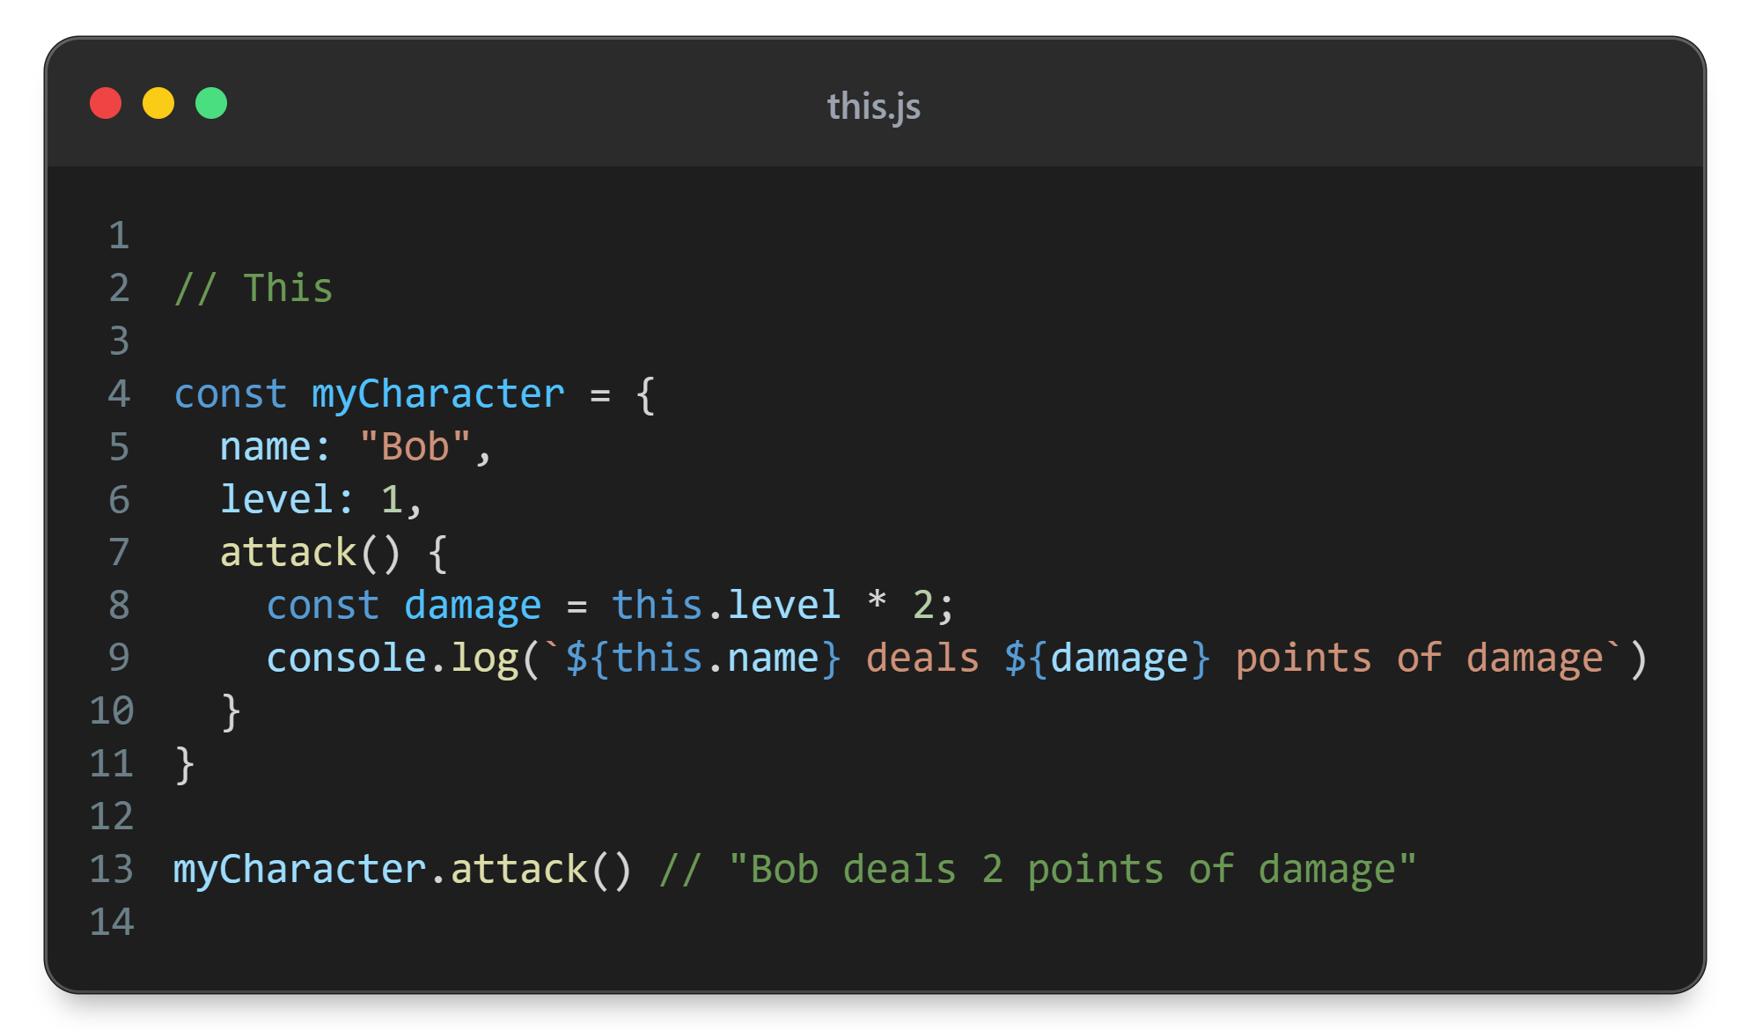

Slide 19
this
A ‘variable’ that is created in every context (except arrow functions)
It points to ‘context’ or ‘scope within context’
The thing it points to depends only on how the context was created

Slide 20
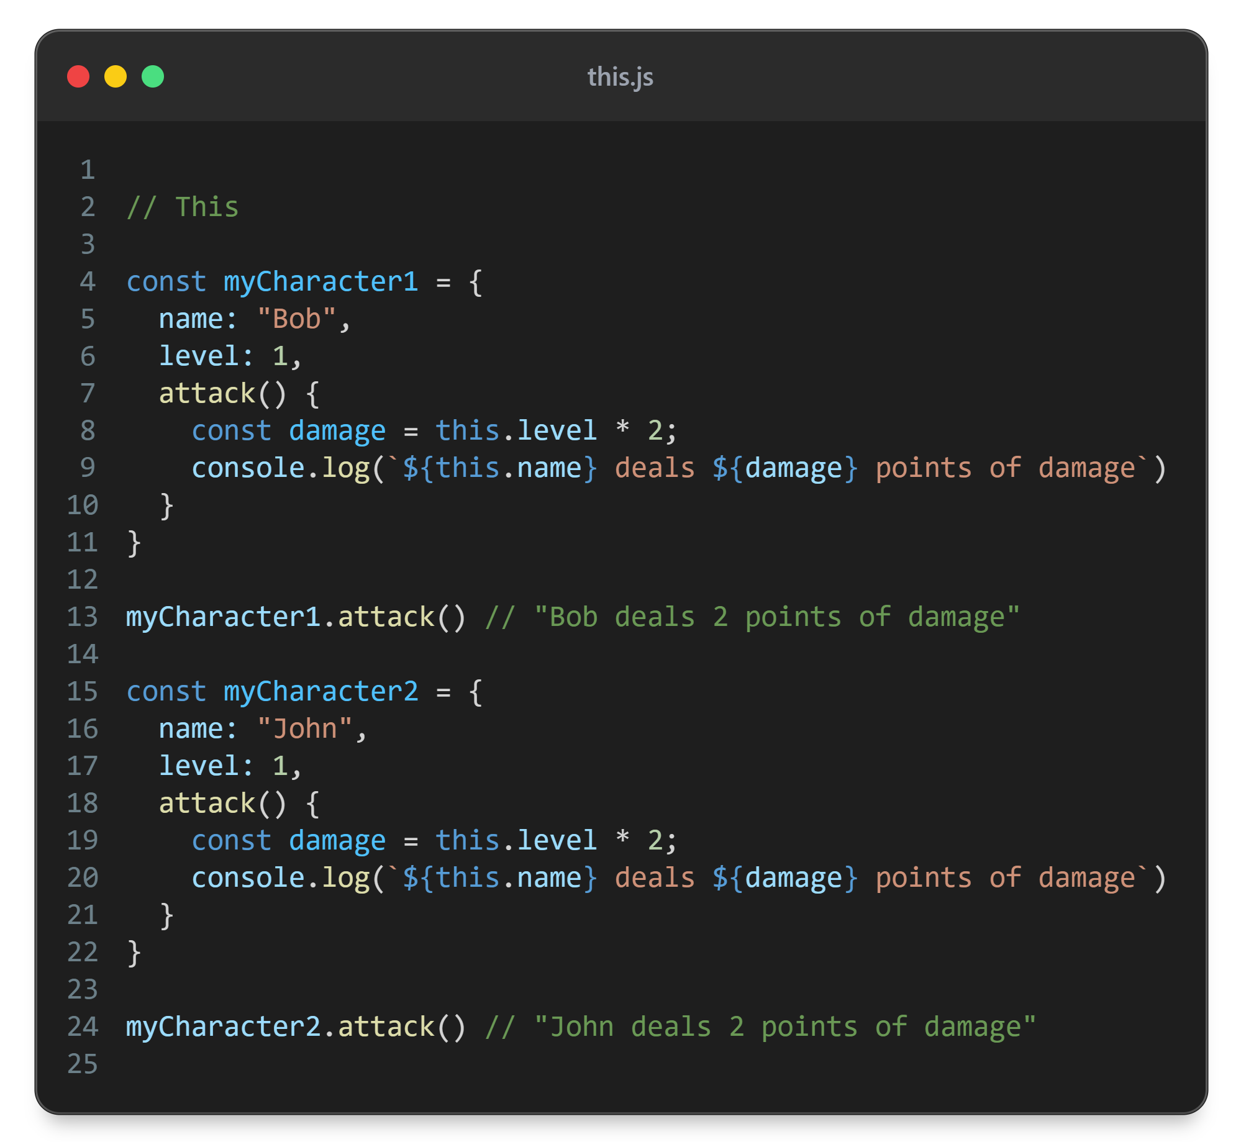
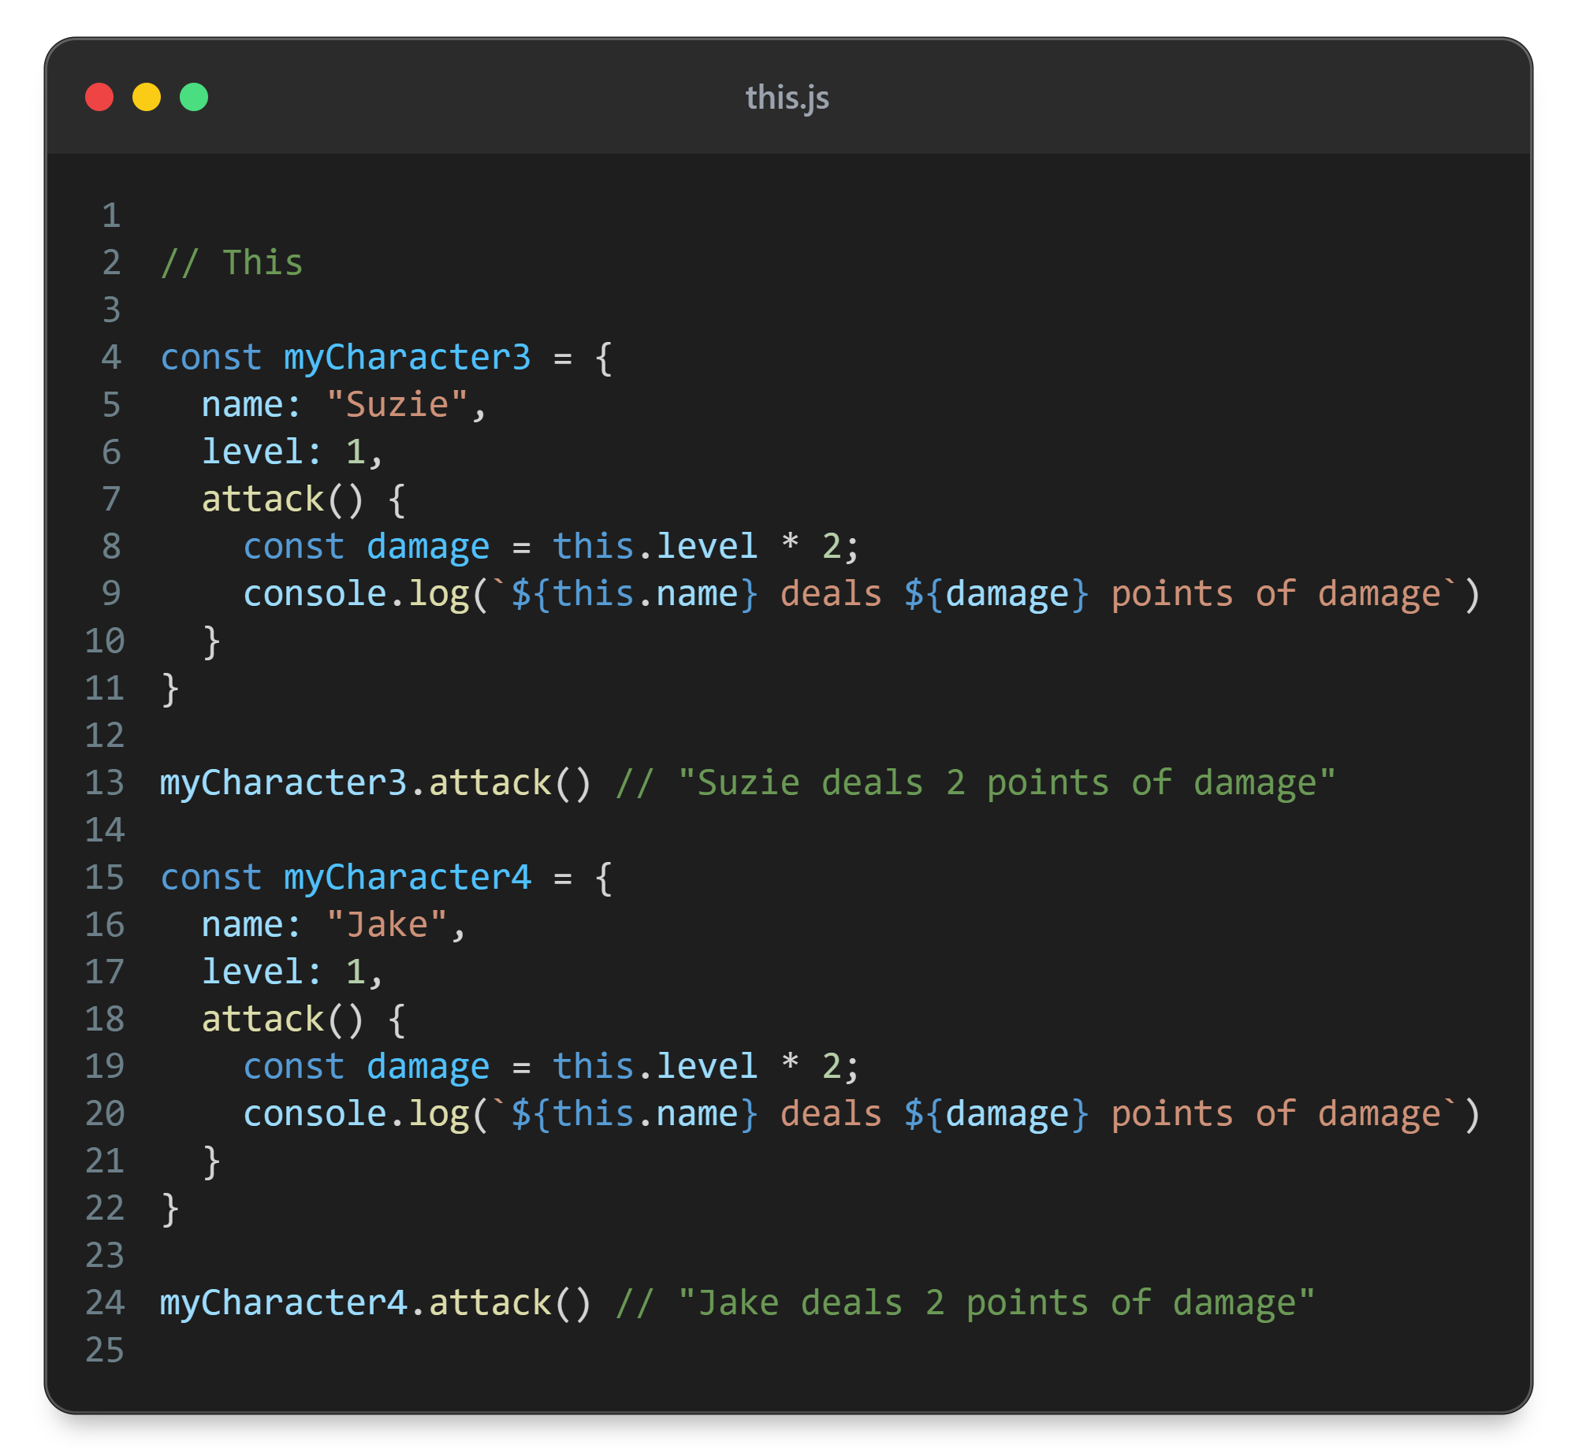

Slide 21
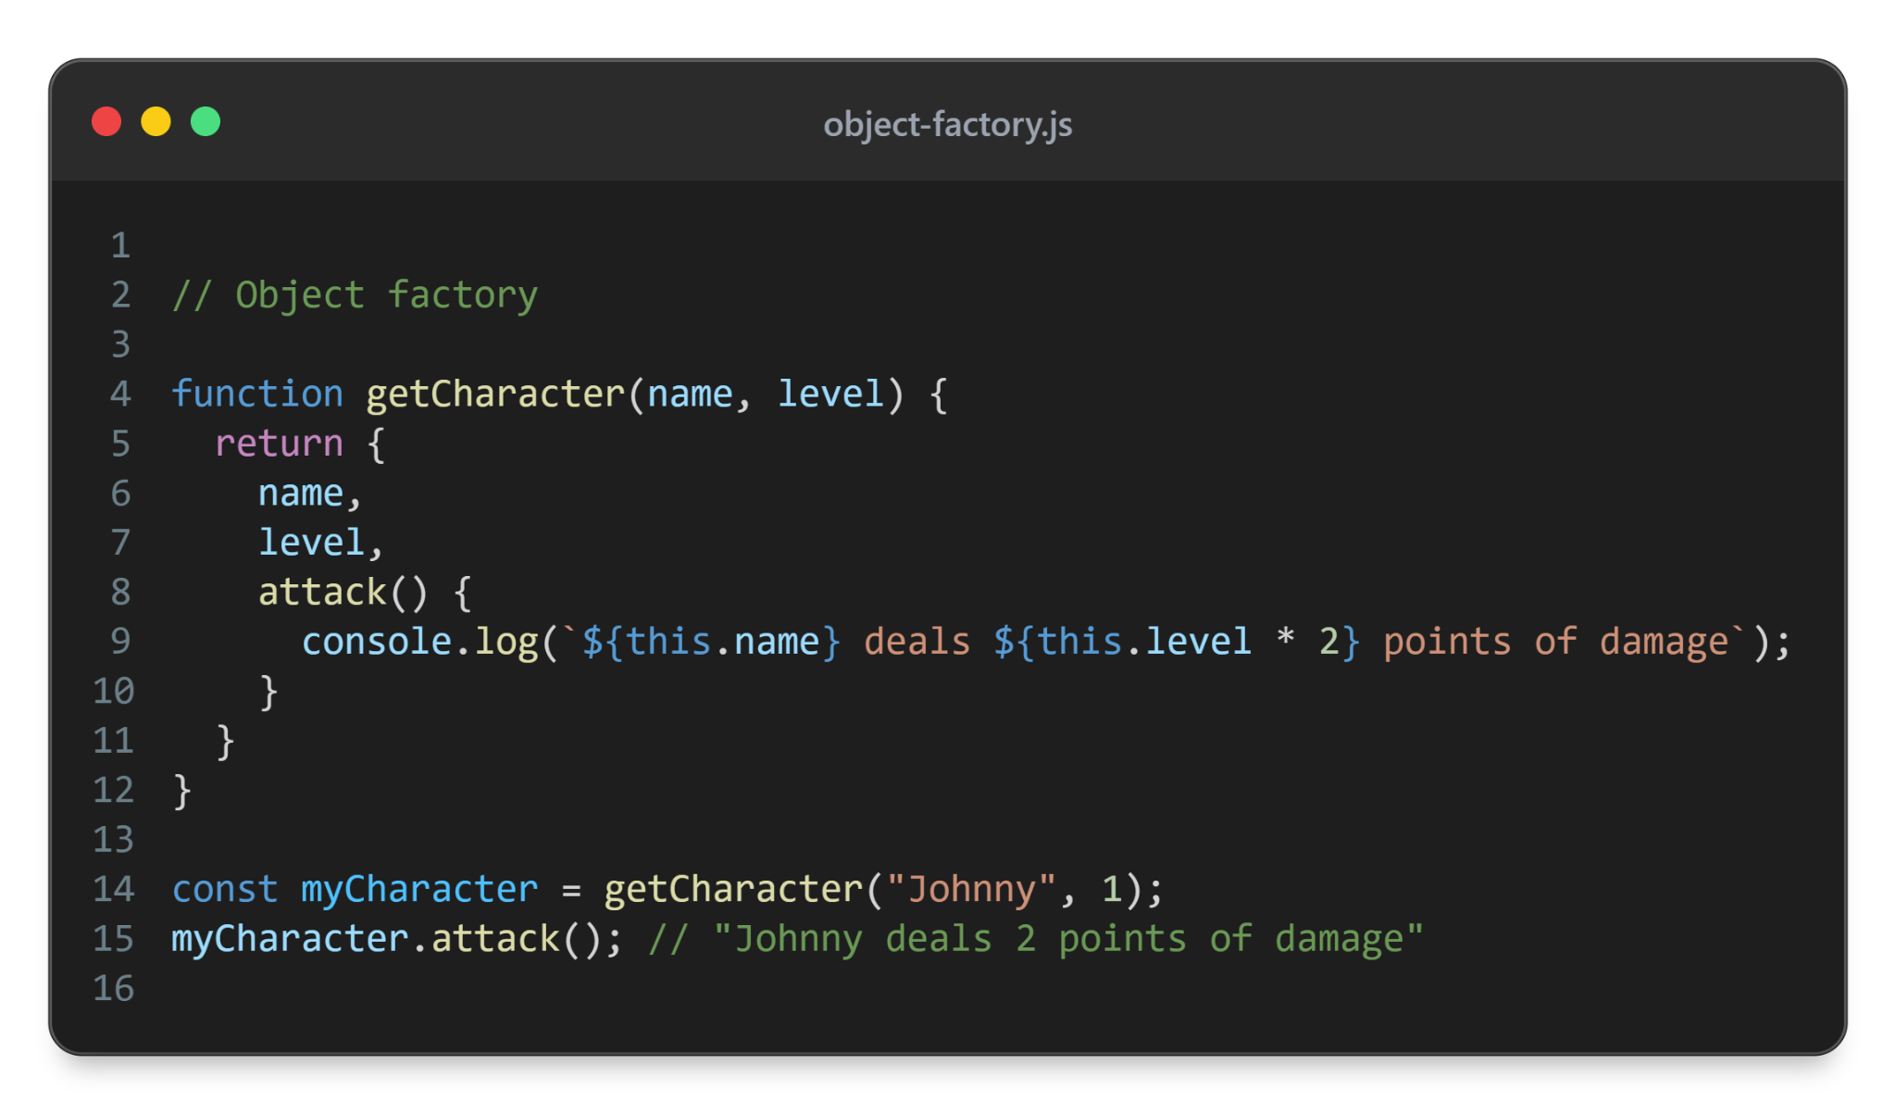

Slide 22
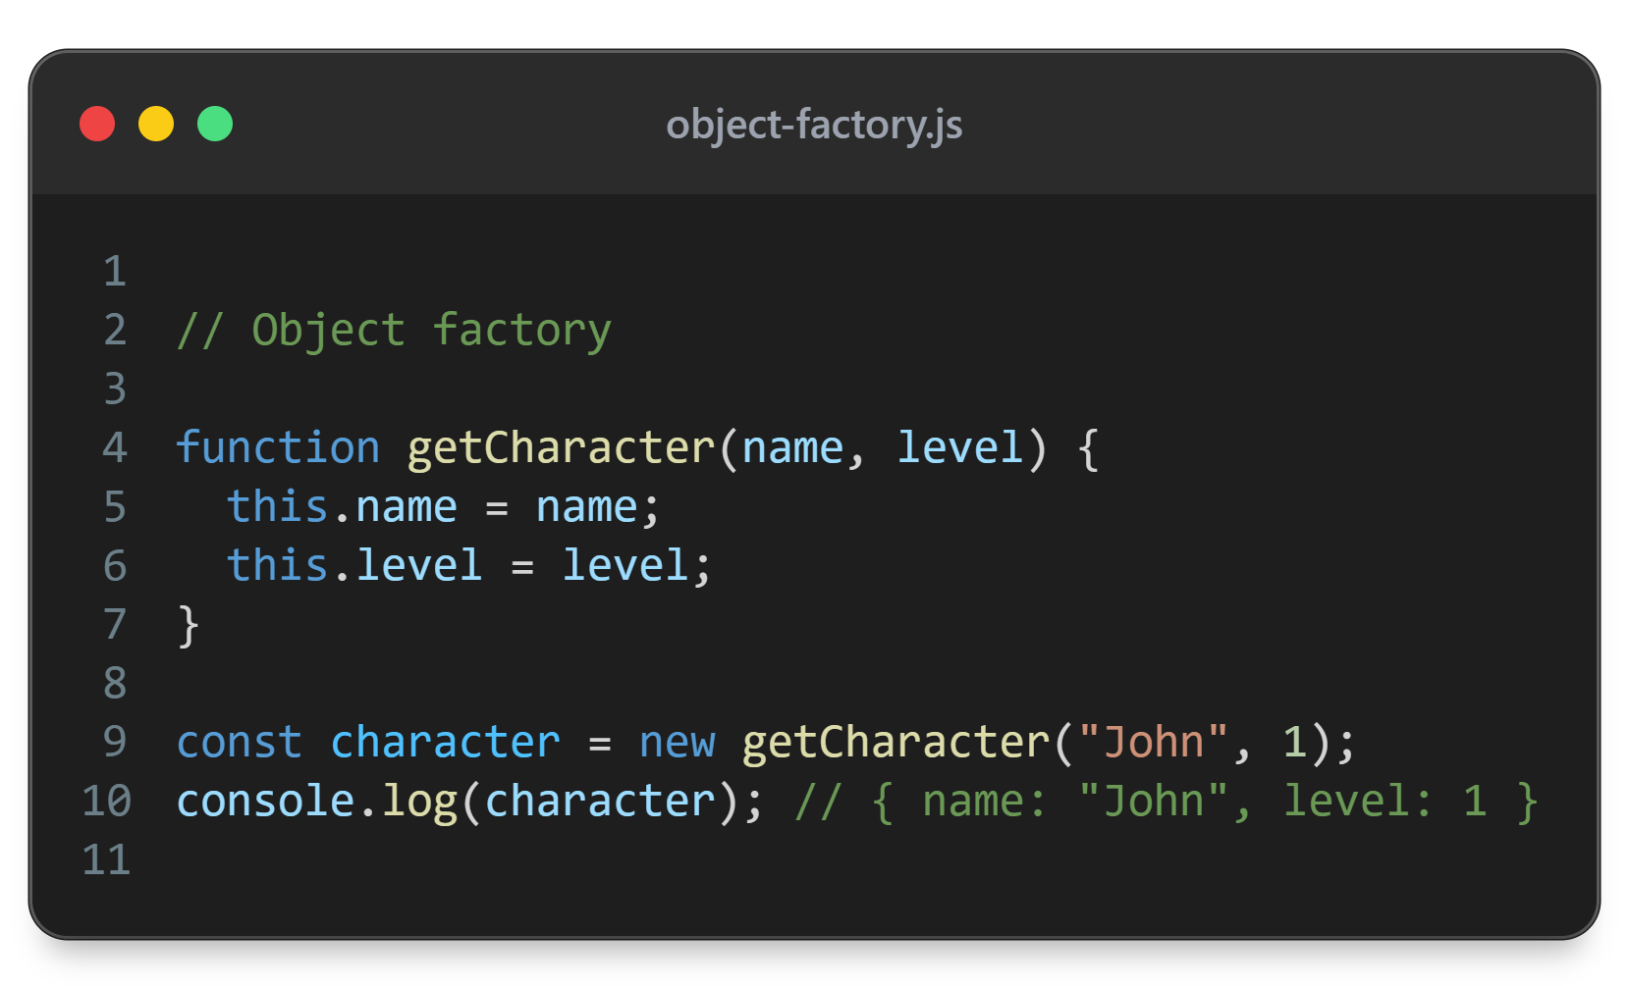

Slide 23
new
Creates new object
Points this at the new object
Connects the object with the prototype where methods are stored
Returns the object

Slide 24

character = new getCharacter(“John”, 1)
Global memory
getCharacter
Local memory
this.name = name
this.level = level
name
John
level
1
this
name: john
level: 1
character
name: john
level: 1

Slide 25
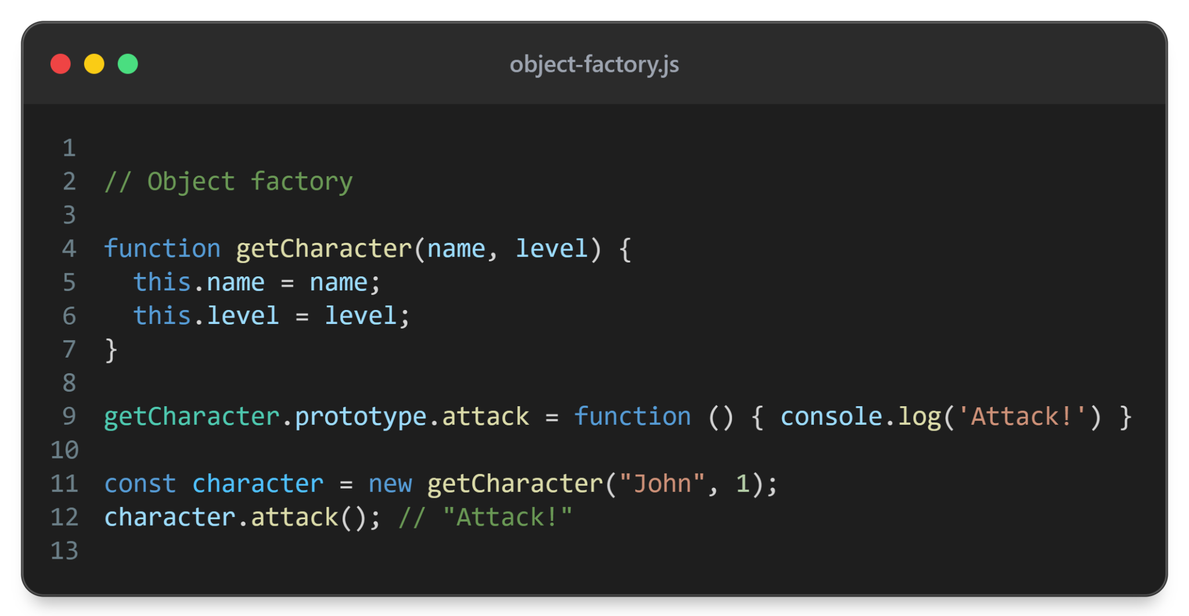

Slide 26
character = new getCharacter(“John”, 1)
Global memory
getCharacter
Local memory
this.name = name
this.level = level
name
John
prototype
level
1
attack
this
name: john
level: 1
__proto__
character
name: john
level: 1
__proto__

Slide 27
classes

Slide 28
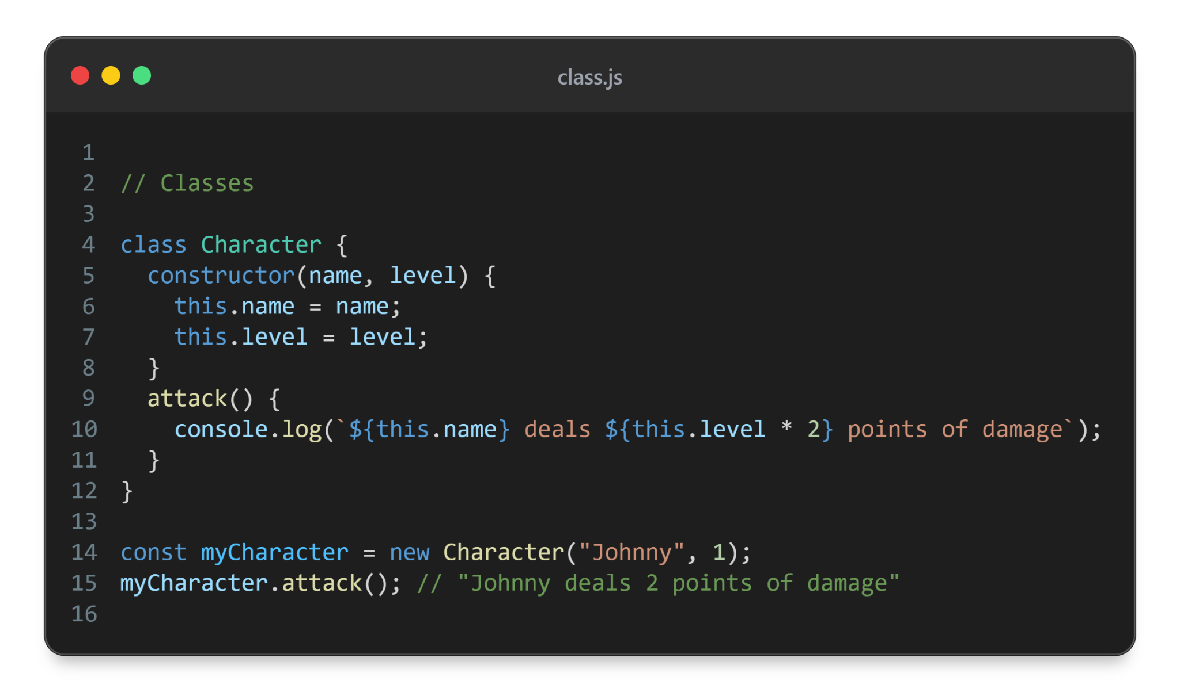
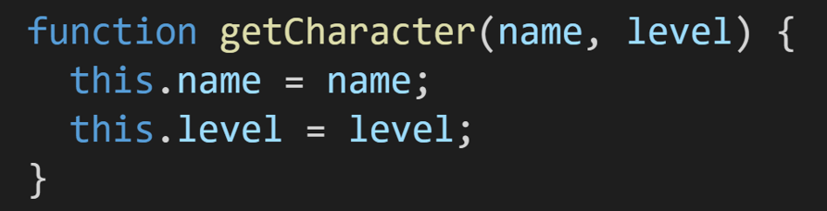

Slide 29
myCharacter = new Character(“Johnny”, 1)
Global memory
constructor
Character
Local memory
this.name = name
this.level = level
name
Johnny
prototype
level
1
attack
this
name: Johnny
level: 1
__proto__
myCharacter
name: Johnny
level: 1
__proto__
myCharacter.attack()

Slide 30
class
function + object combo
The ‘function’ part is the constructor
The ‘object’ part stores all methods under the name ‘prototype’

Slide 31
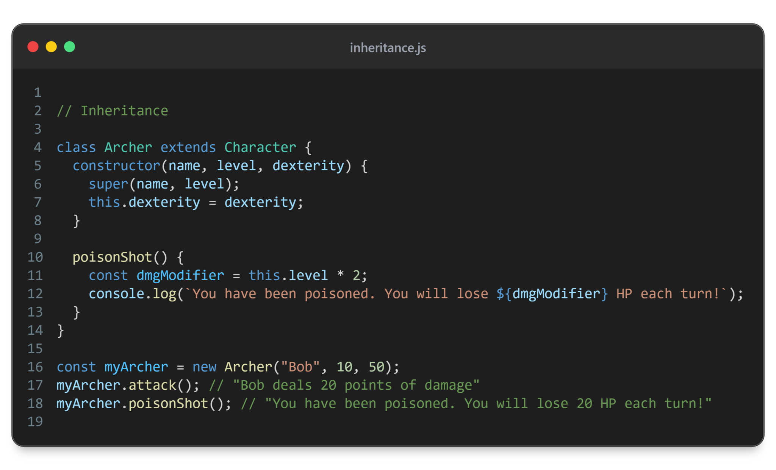

Slide 32
myArcher = new Archer(“Bob”, 10, 50)
Global memory
constructor
Character
super(name, level)
Local memory
this.dexterity = dexterity
name
Bob
prototype
level
10
attack
dexterity
50
this
constructor
Archer
name: Bob
level: 10
prototype
dexterity: 50
poisonShot
__proto__
__proto__
myArcher.attack()
myArcher
name: Bob
level: 10
dexterity: 50
__proto__

Slide 33
super
When extending other class you need to use as a function in constructor to be able to use this
A way to reference parent class

Slide 34
Instanceof
Instanceof allows us to check if object is of certain class
Takes inheritance into account
Returns boolean

Slide 35
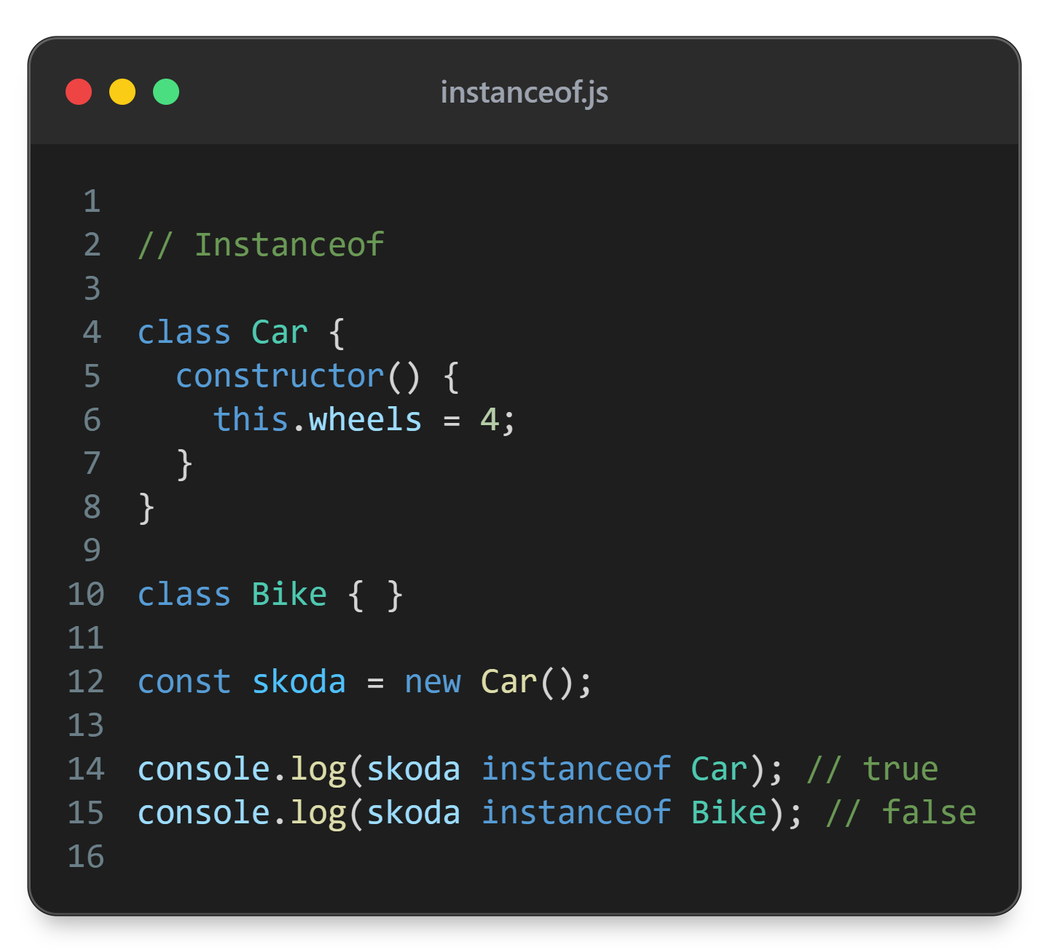

Slide 36
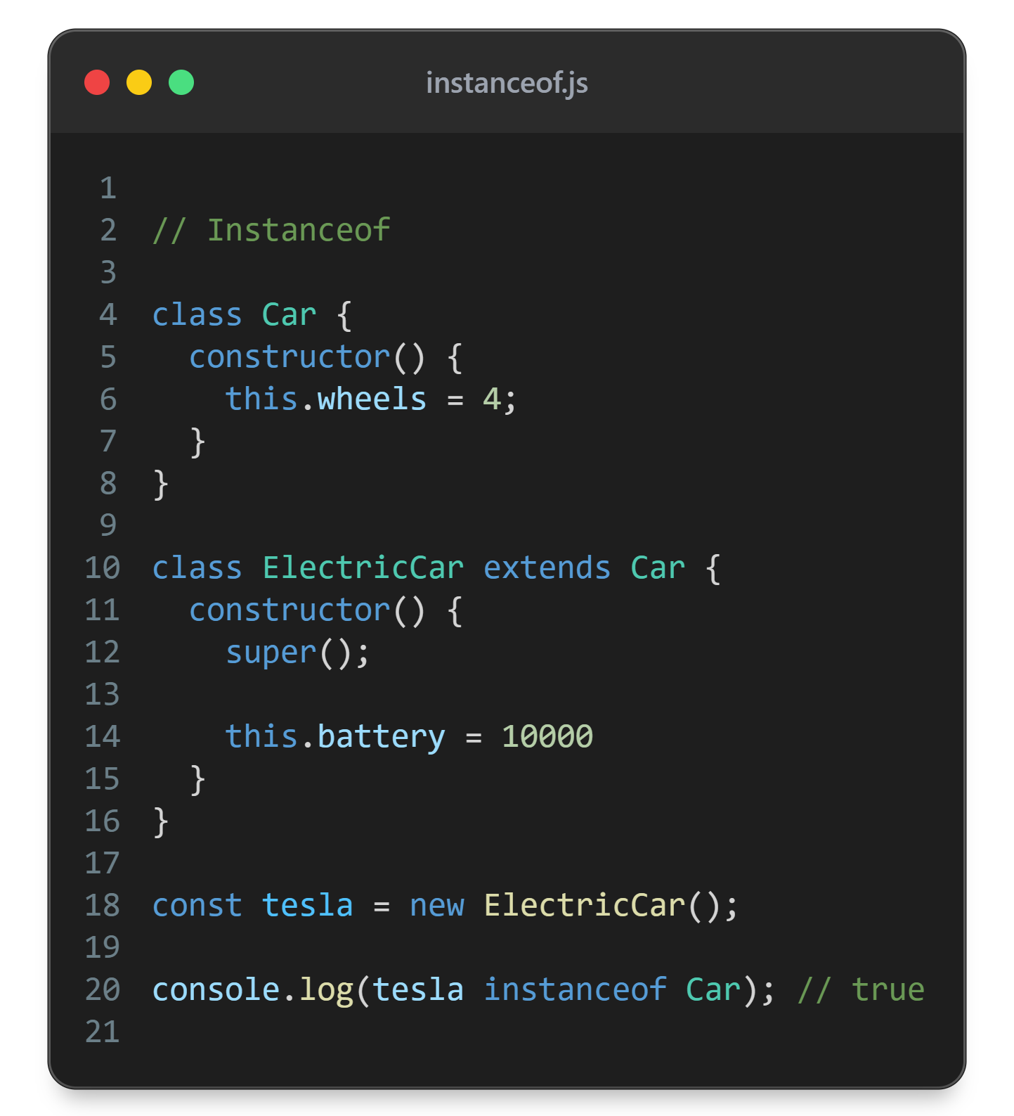

Slide 37
Public instance field
Usually omitted but can be included for more self documenting code

Slide 38
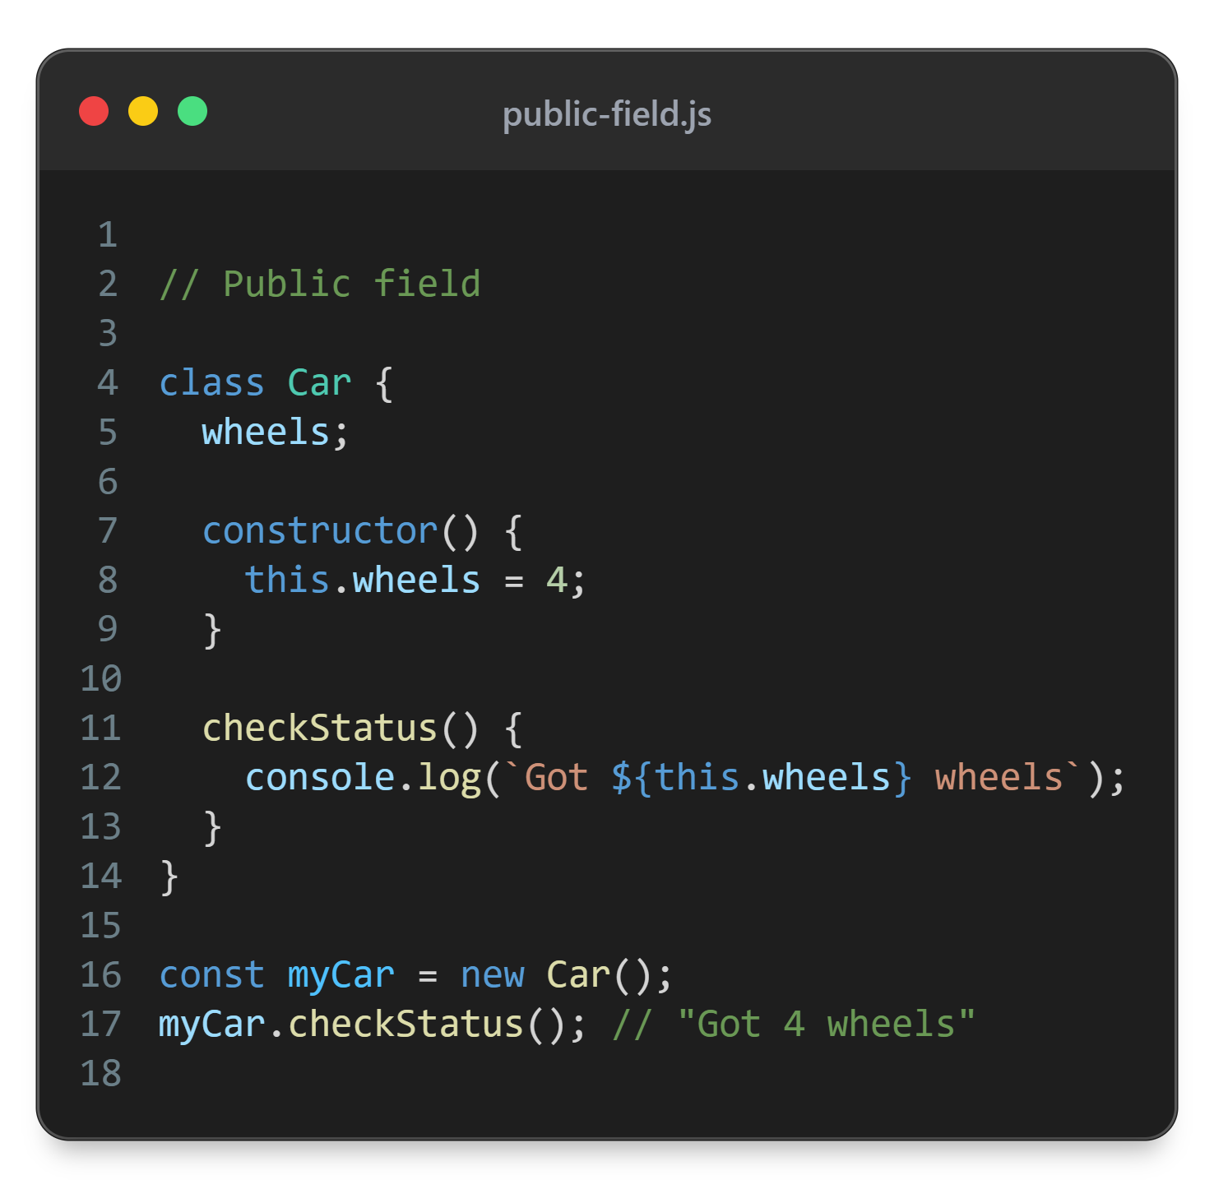

Slide 39
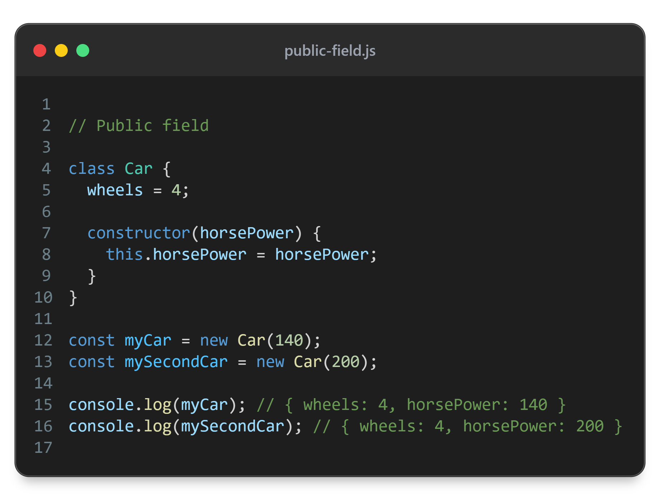

Slide 40
Static fields and methods
Fields and methods that belong to class - not the object created with the class
Usually used to add utility methods to class itself

Slide 41
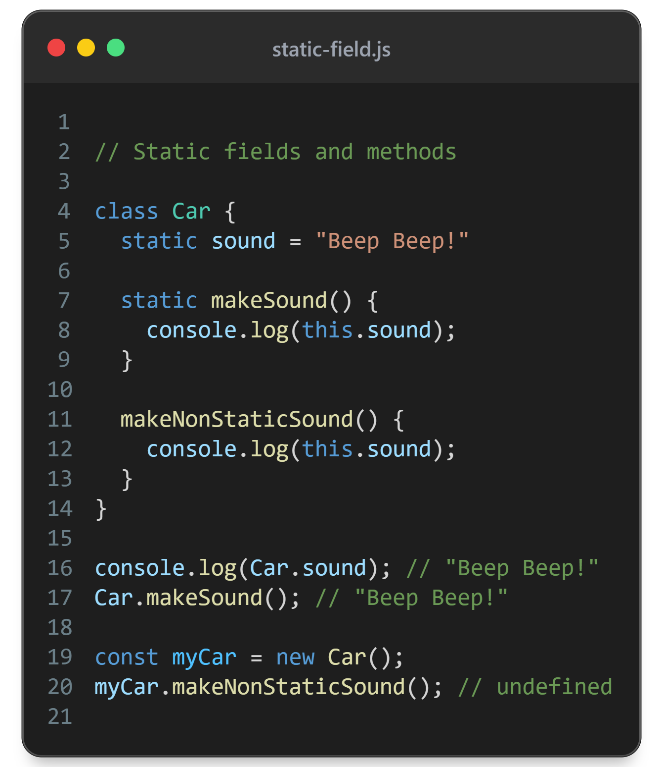

Slide 42
Private fields and methods
Quite new addition to JS
Allows to natively encapsulate data inside class/object
Add # before the name of field

Slide 43
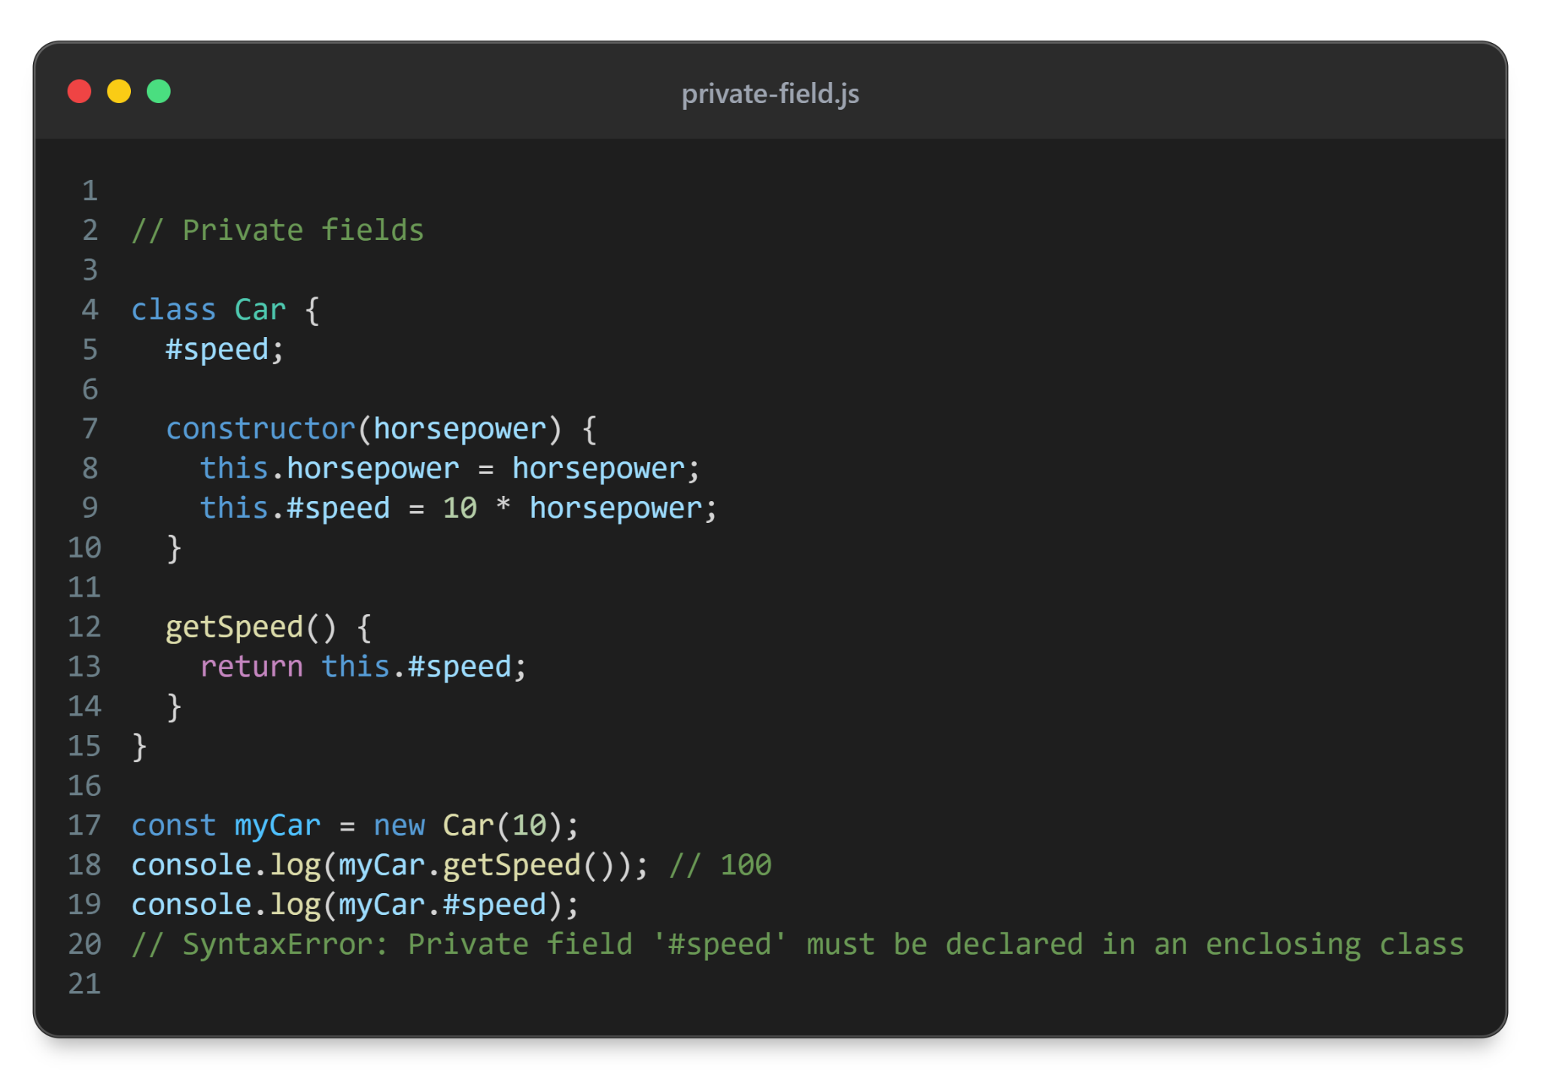

Slide 44
getters and setters
Methods that are used like normal properties
Allow to add extra logic while setting values or add layer of encapsulation

Slide 45
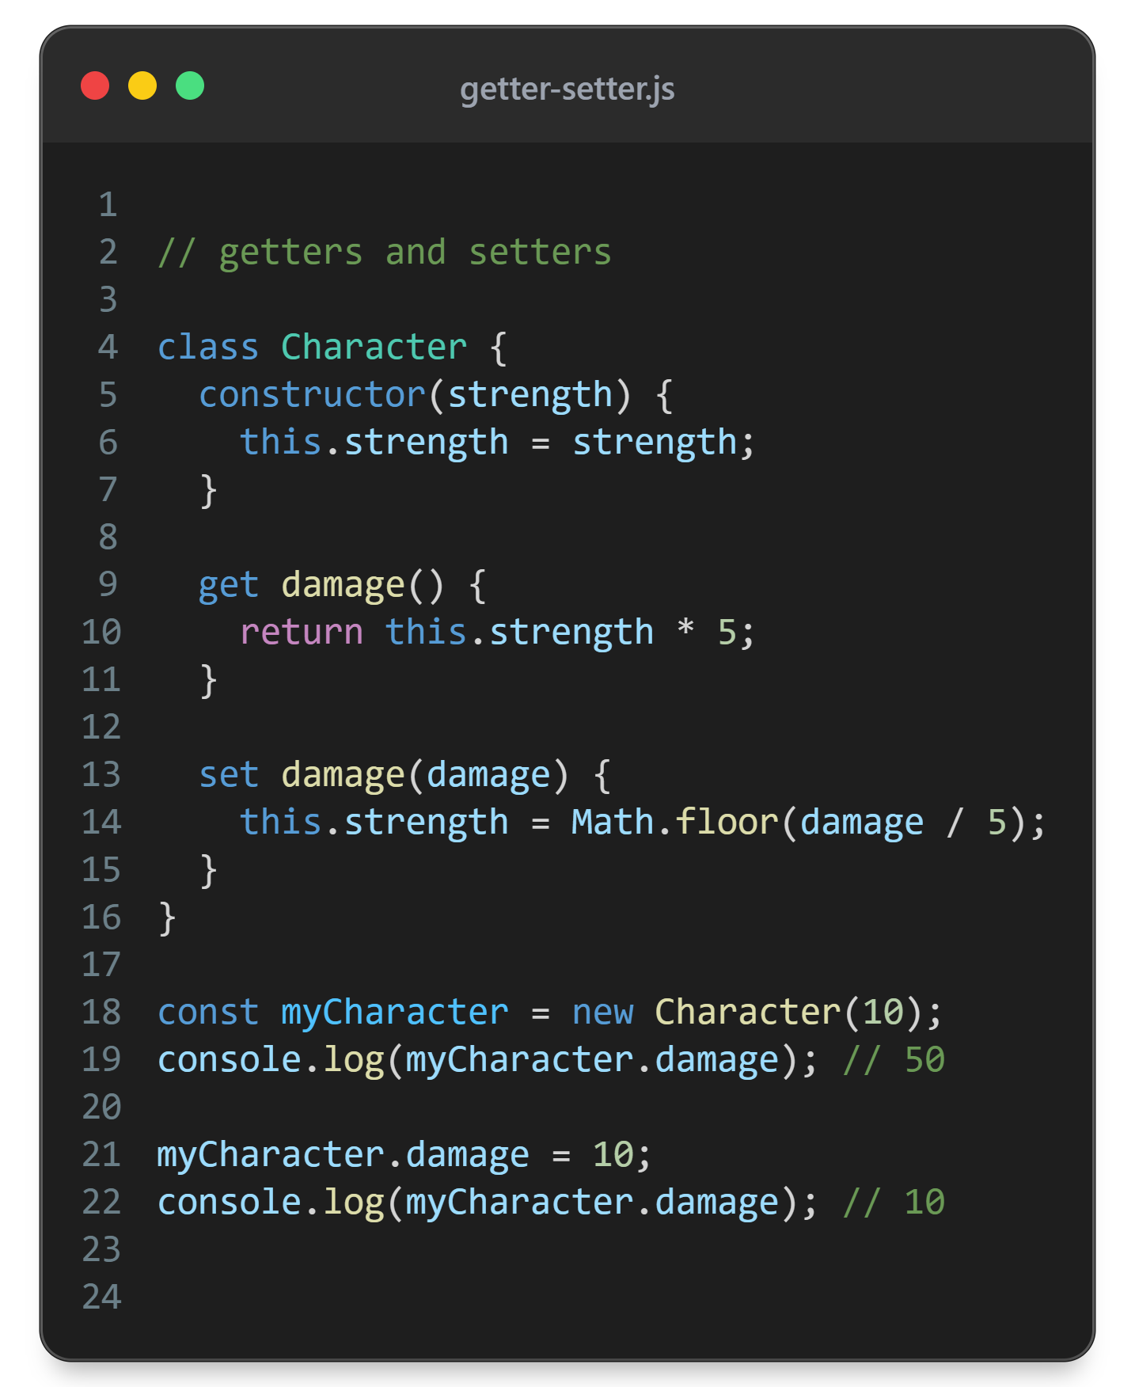

Slide 46


